Slide 1
Open source modeling
as an enabler of transparent decision making
Ian Foster
Computation Institute
University of Chicago & Argonne National Laboratory
Notes:
In a world that is increasingly interconnected, human-modified, and complex, decision makers face problems of unprecedented complexity. For example, how do we meet growing needs for energy while also reducing emissions; how to prepare for natural disasters;
Computer models have emerged as an important tool for understanding such problems.
They can help us understand interrelationships among entities in complex systems of systems.
Abstract:
In an increasingly interconnected and human-modified world, decision makers face problems of unprecedented complexity. For example, world energy demand is projected to grow by a factor of four over the next century. During that same period, greenhouse gas emissions must be drastically curtailed if we are to avoid major economic and environmental damage from climate change. We will also have to adapt to climate change that is not avoided. Governments, companies, and individuals face what will be, in aggregate, multi-trillion-dollar decisions.
These and other questions (e.g., relating to food security and epidemic response) are challenging because they depend on interactions within and between physical and human systems that are not well understood. Furthermore, we need to understand these systems and their interactions during a time of rapid change that is likely to lead us to states for which we have limited or no experience. In these contexts, human intuition is suspect. Thus, computer models are used increasingly to both study possible futures and identify decision strategies that are robust to the often large uncertainties.
The growing importance of computer models raises many challenging issues for scientists, engineers, decision makers, and ultimately the public at large. If decisions are to be based (at least in part) on model output, we must be concerned that the computer codes that implement numerical models are correct; that the assumptions that underpin models are communicated clearly; that models are carefully validated; and that the conclusions claimed on the basis of model output do not exceed the information content of that output. Similar concerns apply to the data on which models are based. Given the considerable public interest in these issues, we should demand the most transparent evaluation process possible.
I argue that these considerations motivate a strong open source policy for the modeling of issues of broad societal importance. Our goal should be that every piece of data used in decision making, every line of code used for data analysis and simulation, and all model output should be broadly accessible. Furthermore, the organization of this code and data should be such that any interested party can easily modify code to evaluate the implications of alternative assumptions or model formulations, to integrate additional data, or to generate new derived data products. Such a policy will, I believe, tend to increase the quality of decision making and, by enhancing transparency, also increase confidence in decision making.
I discuss the practical implications of such a policy, illustrating my discussion with examples from the climate, economics, and integrated assessment communities. I also introduce the use of open source modeling with the University of Chicago's new Center on Robust Decision making for Climate and Energy Policy (RDCEP), recently funded by the US National Science Foundation.

Slide 2
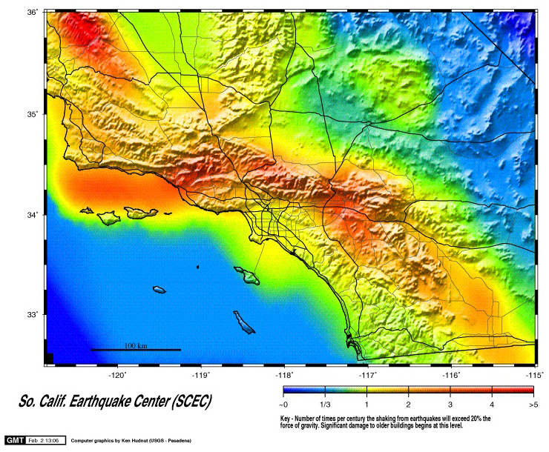

Notes:
For example, earthquake hazard maps, which are constructed by integrating information from many different sources to estimate the chance of severe ground movement.

Slide 3
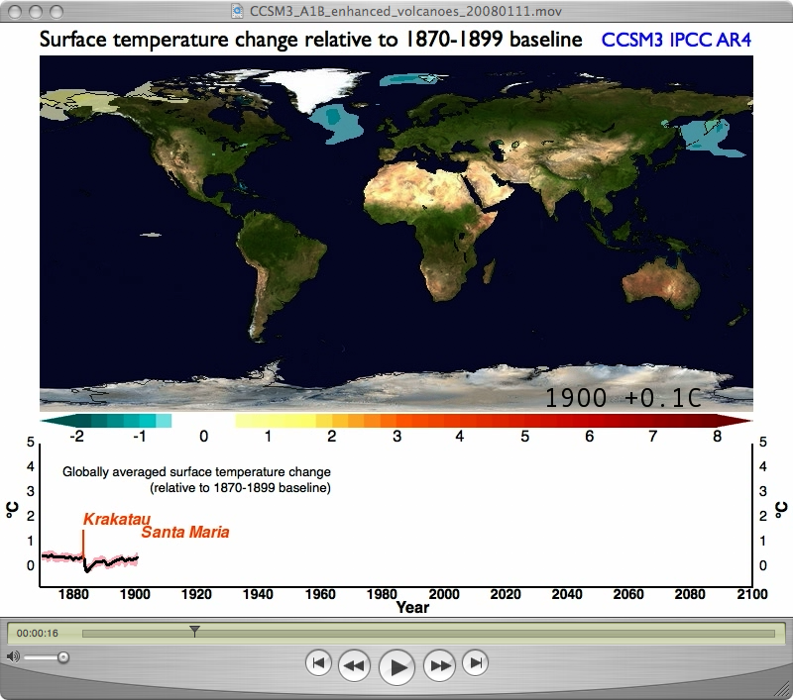
Notes:
Also climate models
For example, I show here results obtained using a state-of-the-art climate model, the Community Climate System Model from the National Center for Atmospheric Research in the US. The model is first used to replicate historical surface temperature data, from 1870 to the present, and then to predict future temperatures under different emission scenarios.

Slide 4
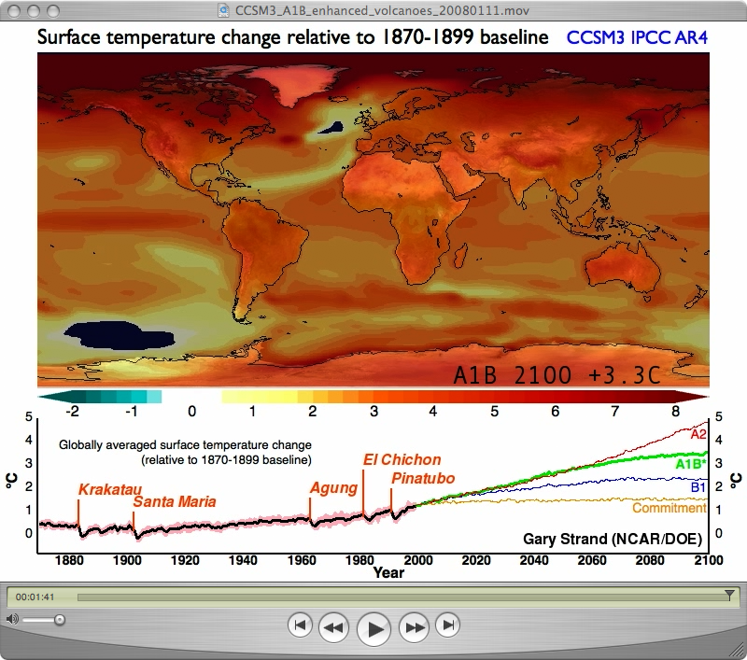
Notes:
Motivate the problem: climate
Here we show the predictions for 2100 for the A1B scenario.
B stands for "Balanced" progress across all resources and technologies from energy supply to end use
This image captures three important things:
The remarkable advances that have been achieved in numerical climate simulation;
The apparently substantial impacts that we may expect from climate change; and
The central role that human behavior plays in determining our future

Slide 5
Wicked problem
Mess
Super wicked problem
Notes:
Each of these applications has distinct characteristics:
-- It is inordinately complex, involving a system of systems. But that’s not all
-- Highly dependent on data that is sparse and inadequate
-- No immediate way to test projections—any solution is an experiment with outcome far in future
-- Consequences of failure to make the right decision are substantial
-- Human decision making is ultimately part of the mix.
Thus, a computer simulation of an Airbus A380 is not the sort of problem I am talking about—complex though it may be.
It turns out that there is a literature on these sorts of problems, dating back to 1970s.
Technical terms, that you may find interesting to review. I won’t go into details.

Slide 6
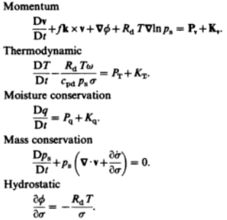
The “primitive equations” of atmospheric dynamics
The Global Climate, J. Houghton (Ed), CUP, 1985, p41
Notes:
Let’s look at how a climate model works.
The basic equations are derived from fundamental physical laws, relating for example to the conservation of mass and momentum, and laws of thermodynamics, but also including terms that refer to external forcing from processes such as convection and solar heating.
Human inputs occur via, for example, greenhouse gas forcing.
Also significant unknowns—for example, how exactly do clouds work, will Greenland ice sheet collapse.

Slide 7
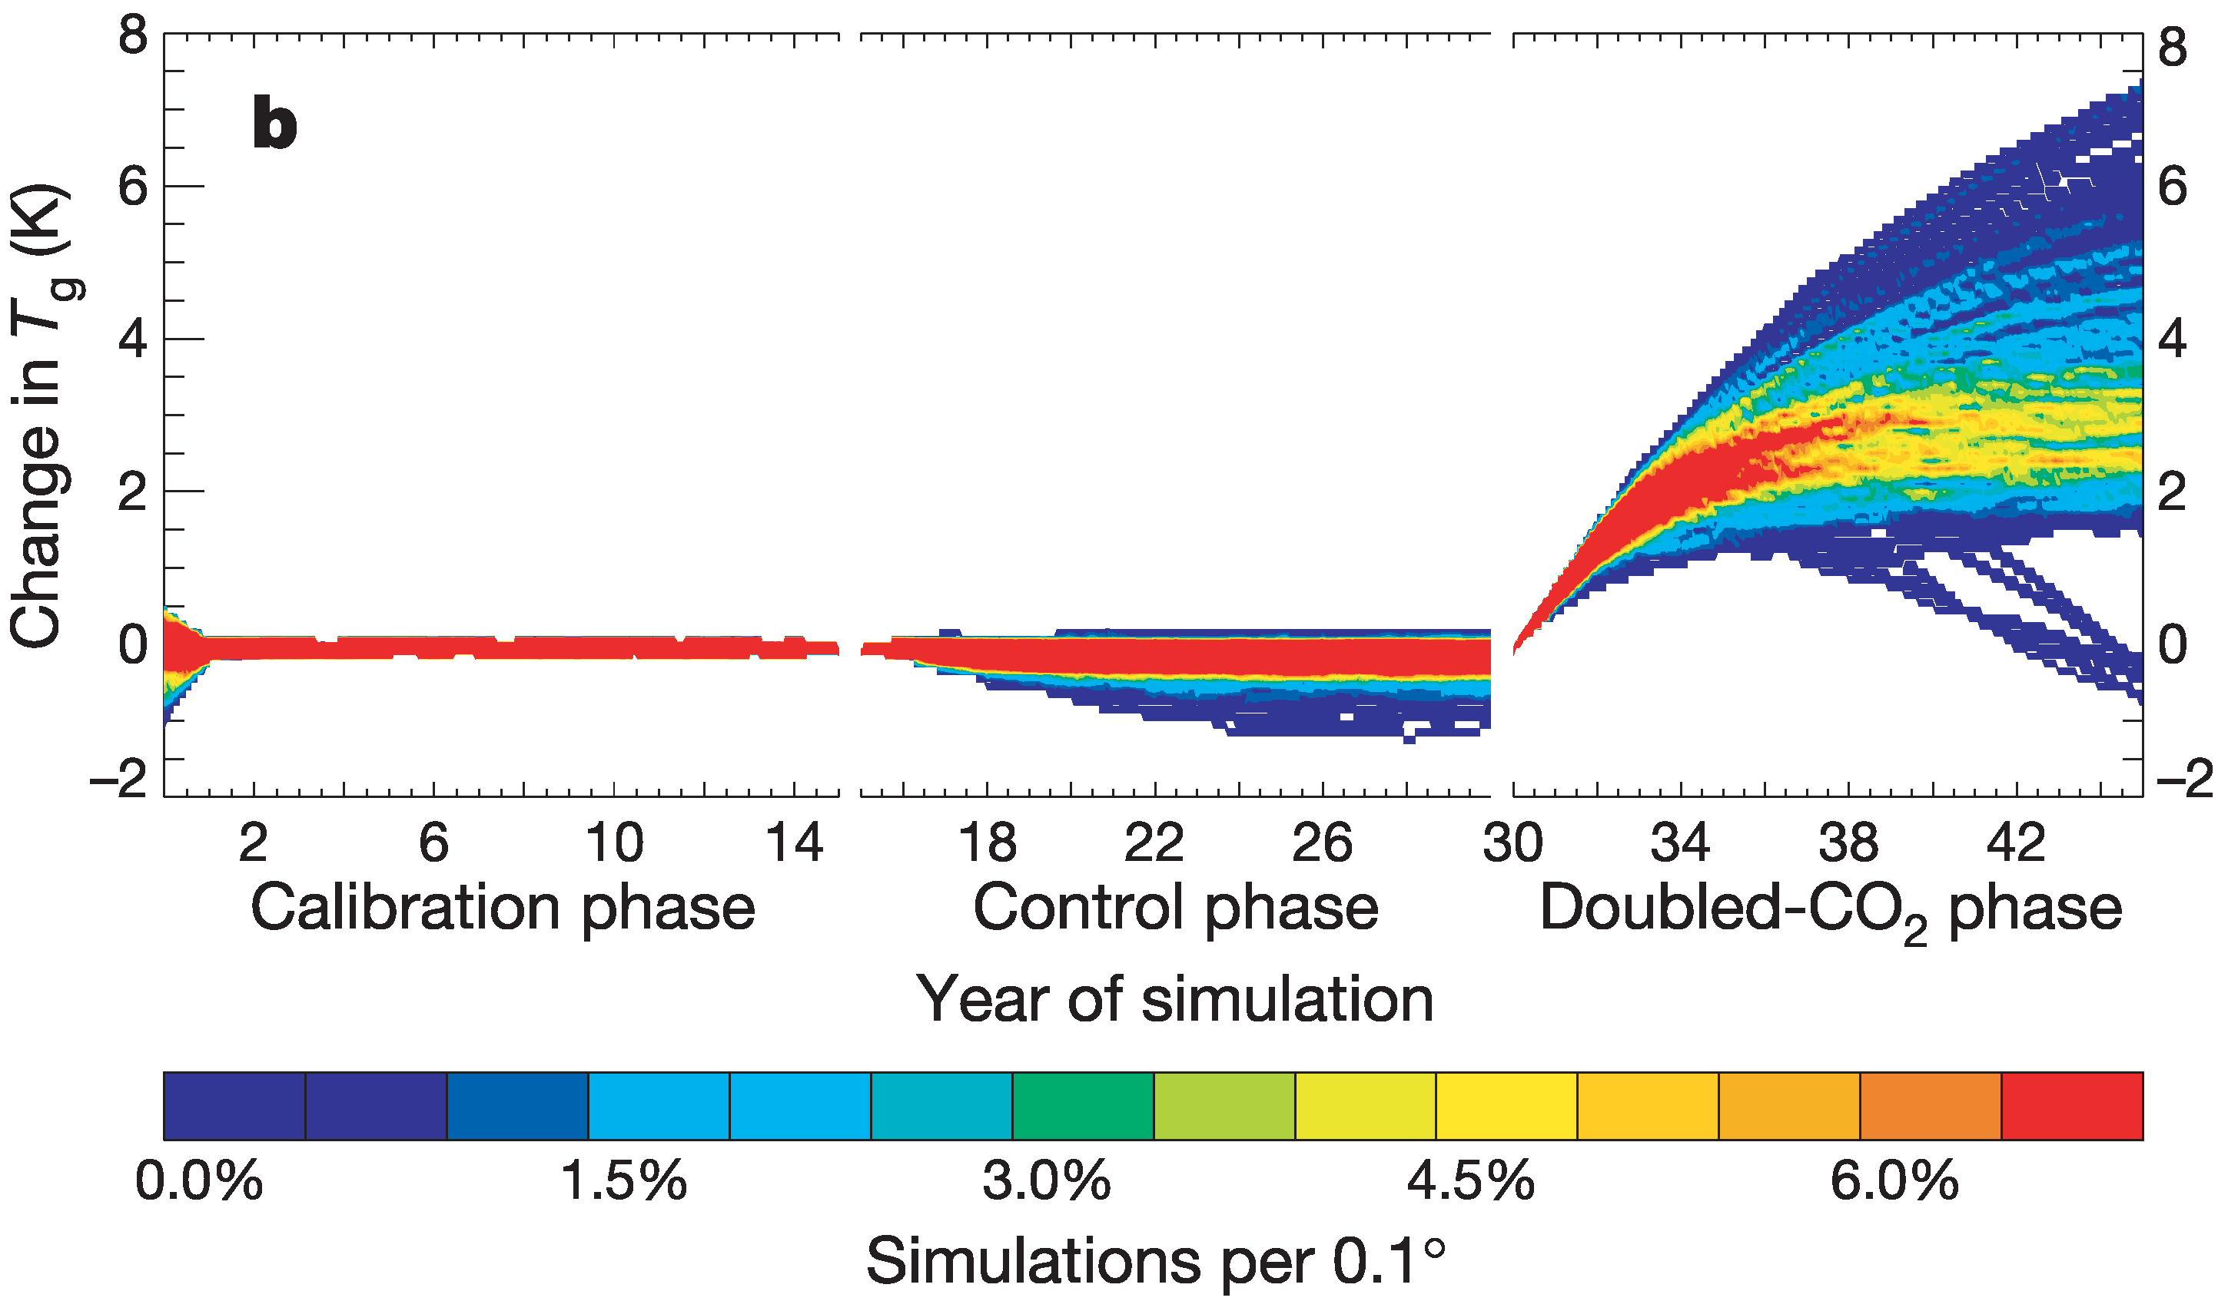
Notes:
Many models have been developed—the most recent IPCC assessment involved XX models.
We can compare these models by running a standard scenario, so as CO2 doubling.
First adjust them for historical data. A “fitting” exercise given free parameters in models.

Slide 8
Notes:
Control phase …

Slide 9
Notes:
Then CO2 doubling.
A clear signal, but also significant differences. Surely important that we account for these differences, which are major. A lot of discussion about scientific reasons, but ultimately we can’t know without looking at implementations. Different formulations? Different data? Different implementation methods? Coding mistakes?

Slide 10
Model | Nationality | Open source ?
BCC | China
BCCR | Norway
CCSM | USA
CGCM | Canada
CNRM | France
CSIRO | Aus
ECHAM | Germany
ECHO-G | Germany
FGOALS | China
GFDL | USA
GISS | USA
INM | Russia
MIROC | Japan
MRI | Japan
PCM | USA
UKMO | UK
Andy Pitman and Steven Phipps, UNSW (FOSS4G keynote, 2009)
Notes:
But looking at source code is difficult!! UNSW researchers …

Slide 11
Model | Nationality | Open source ?
BCC | China | No
BCCR | Norway | Noi
CCSM | USA
CGCM | Canada | No
CNRM | France | No
CSIRO | Aus
ECHAM | Germany | No
ECHO-G | Germany
FGOALS | China | No
GFDL | USA
GISS | USA
INM | Russia | No
MIROC | Japan | No
MRI | Japan | No
PCM | USA | No
UKMO | UK
Andy Pitman and Steven Phipps, UNSW (FOSS4G keynote, 2009)

Slide 12
Model | Nationality | Open source ?
BCC | China | No
BCCR | Norway | No
CCSM | USA
CGCM | Canada | No
CNRM | France | No
CSIRO | Aus | Via license, never latest version
ECHAM | Germany | No
ECHO-G | Germany
FGOALS | China | No
GFDL | USA
GISS | USA
INM | Russia | No
MIROC | Japan | No
MRI | Japan | No
PCM | USA | No
UKMO | UK | Via license, never latest version
Andy Pitman and Steven Phipps, UNSW (FOSS4G keynote, 2009)

Slide 13
Model | Nationality | Open source ?
BCC | China | No
BCCR | Norway | No
CCSM | USA
CGCM | Canada | No
CNRM | France | No
CSIRO | Aus | Via license, never latest version
ECHAM | Germany | No
ECHO-G | Germany | A variant may be available
FGOALS | China | No
GFDL | USA | A variant may be available
GISS | USA
INM | Russia | No
MIROC | Japan | No
MRI | Japan | No
PCM | USA | No
UKMO | UK | Via license, never latest version
Andy Pitman and Steven Phipps, UNSW (FOSS4G keynote, 2009)

Slide 14
Model | Nationality | Open source ?
BCC | China | No
BCCR | Norway | No
CCSM | USA | Yes – fully accessible
CGCM | Canada | No
CNRM | France | No
CSIRO | Aus | Via license, never latest version
ECHAM | Germany | No
ECHO-G | Germany | A variant may be available
FGOALS | China | No
GFDL | USA | A variant may be available
GISS | USA | Yes – fully accessible
INM | Russia | No
MIROC | Japan | No
MRI | Japan | No
PCM | USA | No
UKMO | UK | Via license, never latest version
Andy Pitman and Steven Phipps, UNSW (FOSS4G keynote, 2009)
Notes:
So: Models that are providing advice on arguably the most important problem facing humanity today—models that are all funded by governments—are for the most part not accessible.
Many reasons given: Expensive to change. Open to abuse. Rent seeking. Embarrassment?
Many stronger reason for making open source:
-- Permits more extensive comparisons among models
-- Many eyes provide opportunities to improve models
-- Increases confidence in outputs: transparency is good.
All climate models should be open. We probably don’t need so many models.
What do mean by “open”? Accessible, understandable, extensible/modifiable. Not just legal but also software engineering.
What should be “open”? Everything required to construct, run, and evaluate models. Data. Data calibration routines. Models.

Slide 15
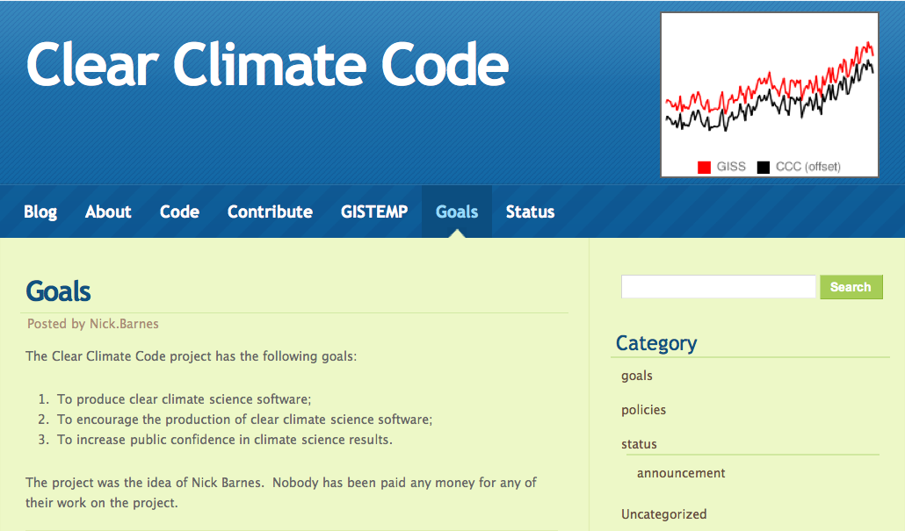

Slide 16
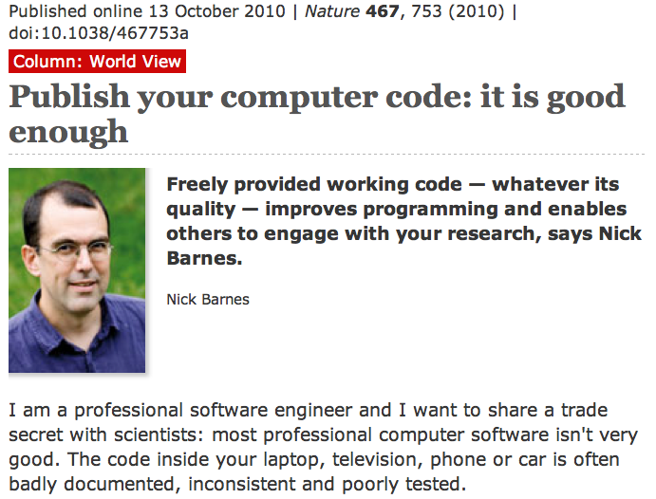

Slide 17
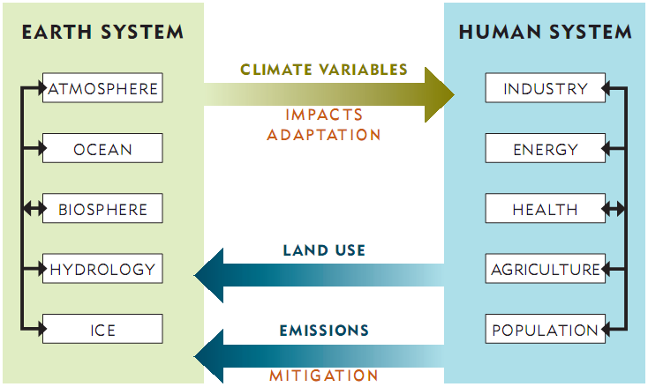
Notes:
So let’s look at the biggest mess of them all: human responses to climate change.
Extremely complex system of systems.

Slide 18
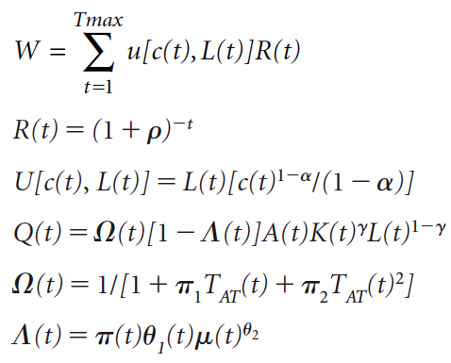
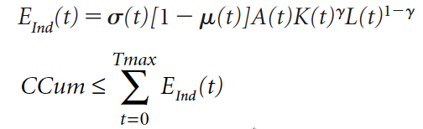
A subset of the DICE model
A Question of Balance, W. Nordhaus, 2008, p205
Notes:
Economic models also solve a set of equations. Here: a subset of equations used in DICE, a simple model developed by Bill Nordhaus.
Economic models typically solve an optimization problem, e.g., as here—maximize utility--subject to constraints: e.g., production matches consumption, and technological improvement cannot violate laws of thermodynamics.
Coupling occurs via terms such as temperature that may be obtained from earth system model.
Coupling is complicated by the fact that human behavior can be effected by expectations concerning the future—so the very act of modeling may effect the future—results in optimization over time.
DICE model is interesting because it is open. And incredibly simplistic. Yet influential because open.

Slide 19
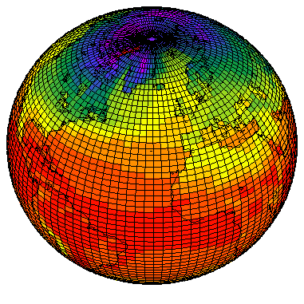
Coarse-grained 64x128 (~2.8°) grid used in 4th Intergovernmental Panel on Climate Change (IPCC) studies
Notes:
Today’s climate models provide significant detail, partitioning the globe into 10,000 or more
grid cells, and are run on supercomputers.

Slide 20
ROE
ROO
EIT
EUM
USA
CHN
JPN
AOE
IND
ROW
ANI
W
LAM
Oxford CLIMOX model
Notes:
Nordhaus model has XX regions.
Here we show a model with 12 regions, runs on a contemporary workstation
Economic modeling lags significantly.
Australia and Canada are treated as one region.

Slide 21
Opportunities for improvement
Resolution: geographic, sectoral, population
Resource accounting: fossil fuels, water, etc.
Human expectations, investment decisions
Intrinsic stochasticity
Uncertainty and human response to uncertainty
Impacts, adaptation
Capital vintages
Technological change
Institutional and regulatory friction
Imperfect competition
Human preferences
Population change
Trade, leakages
National preferences, negotiations, conflict

Slide 22

Republicans: “According to an MIT study, cap and trade could cost the average household more than $3,100 per year”
Reilly: “Analysis … misrepresented … The correct estimate is approximately $340.”
Reilly: "I made a boneheaded mistake in an Excel spreadsheet.” Revises $340 to $800.
Notes:
What do we notice about this account of work by very distinguished scientists
-- One observation is the use of a single number, rather than a range (no uncertainty)
-- What is shocking is that this study, of enormous policy import, is based on a closed code
-- No reproducibility. No ability to check. Limited credibility.
-- Also, substantial barriers to entry

Slide 23
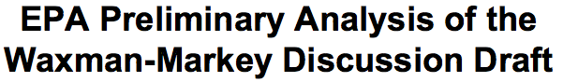
Most existing models are proprietary
ADAGE (RTI Inc.)
IGEM (Jorgenson Assoc.)
IPM (ICF Consulting)
FASOM (Texas A&M)
Four closed models
Notes:
Reminder: Waxman-Markey was …
What’s the state of the art here?
Incredibly simplistic models.
None has accessible code or up-to-date documentation
No third party can easily replicate, study, or extend the EPA analysis

Slide 24

Community Integrated Model of Energy and Resource Trajectories for Humankind (CIM-EARTH)
www.cimearth.org

Slide 25
Center for Robust Decision making on Climate and Energy Policy (RDCEP)
Notes:
RDCEP—NSF Decision Making Under Uncertainty program.
1) Improve fidelity
2) Characterize uncertainty
3) Help identify robust decision strategies
4) Develop open framework and models

Slide 26
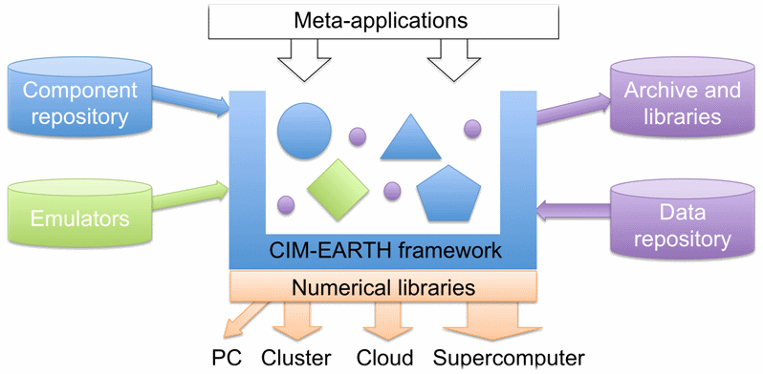

Slide 27
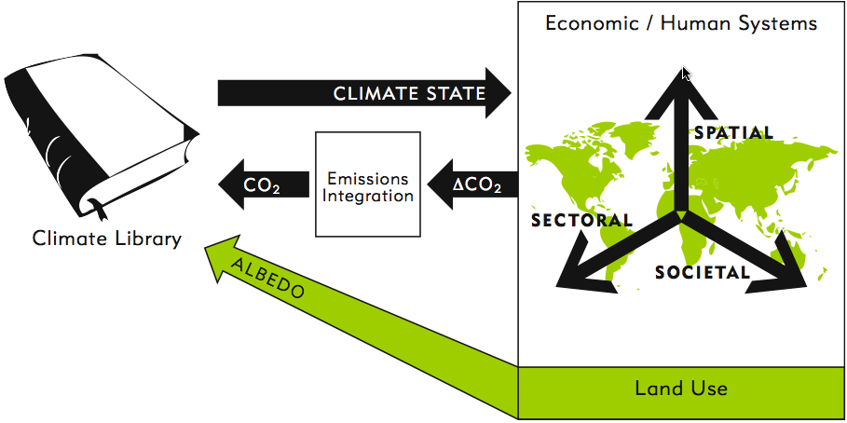
Notes:
First a few words about the basic model. Because of the different execution models of climate and human systems, we adopt a coupling model based on “emulators.”

Slide 28
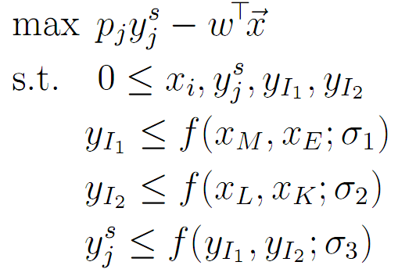
Producer j solves:
Output
σ_{O}
σ_{ME}
σ_{KL}
Materials
Energy
Kapital
Labor
Notes:
Let’s look at a very simplistic version of the economic model.
The producer seeks to meet demand while minimizing cost.
As prices of inputs change, the producer can substitute among inputs, to an extent determine by elasticity of substitution parameters. These parameters are crucial aspects of the model, and a source of considerable uncertainty. They are determined by estimation from historical data.

Slide 29
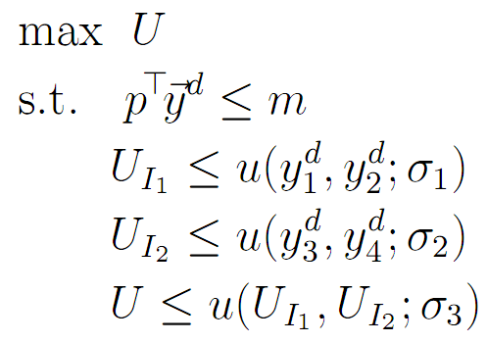
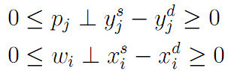
Basic producer problem
Each consumer:
Utility
σ_{U}
σ_{W}
σ_{G}
Widget1
Widget2
Gadget1
Gadget2
Market :
Notes:
The consumer function is similar.
The complementarity condition signified by ⊥ implies that one of the two inequalities in each expression must be saturated. That is, either supply equals demand and the price is nonnegative, or supply exceeds demand and the price is zero. In particular, a zero price means that the market for the good or factor collapses.

Slide 30
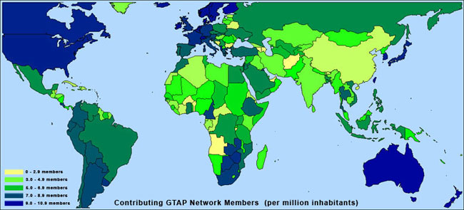
The Global Trade Analysis Project
Notes:
Calibrating the model to data
We use the GTAP I/O matrices to generate fully detailed social accounting matrices for 113 countries/regions
We are augmenting this dataset with detailed region specific data on renewable energy industries, biofuel industries, consumer classifications, labor endowment (skilled and unskilled), improved savings/investment data, …
We include parameterizations of other important dynamic drivers: natural resource extraction and depletion, energy efficiency, and labor productivity in the production functions

Slide 31
Fossil energy reserves
World Oil
Mid East/ N. Afr.
U.S.
Sub S. Africa
Brazil
China
Notes:
Another key dynamic parameter which is also highly uncertain is the future availability of fossil resources around the globe.
Availability especially of liquid fuels from fossil sources is increasingly being called into question, with the general consensus now trending towards an assumption of a peaking global oil supply in the next 10-20 years.
We have developed a statistical model based on data from many sources which forecasts extraction curves country-by-country, with an integral constraint that enforces consistency with geologically estimated ultimately recoverable resources.
This model indeed forecasts a global extraction peak around 2020 for crude oil.
We can then do ensemble uncertainty studies with these forecasts by varying the reserve assumption over a reasonable range and producing a large family of extraction curves.

Slide 33
Difference from 2000 → 2010 cell coverage fractions
Notes:
Preliminary land use change results from large scale biofuel demand
We have completed prototypes of the PEEL dynamic downscaling model and are performing simulations now, so I don’t have a lot of science rich results to show you, but I do have some pretty pictures.

Slide 34
Difference from 2000 → 2022 cell coverage fractions
Notes:
Preliminary land use change results from large scale biofuel demand
We have completed prototypes of the PEEL dynamic downscaling model and are performing simulations now, so I don’t have a lot of results to show you.

Slide 35
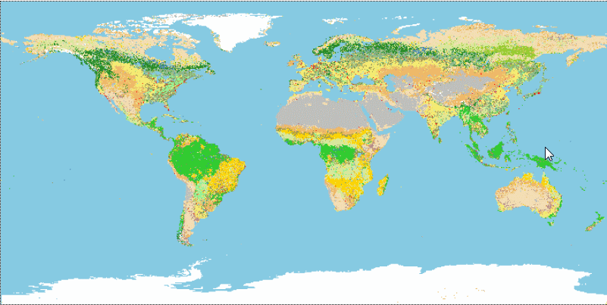
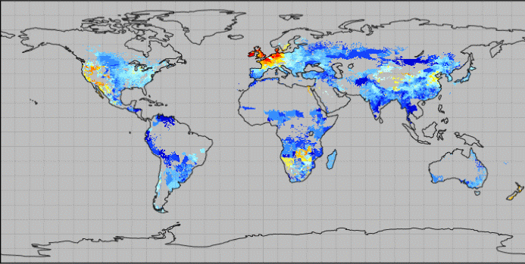
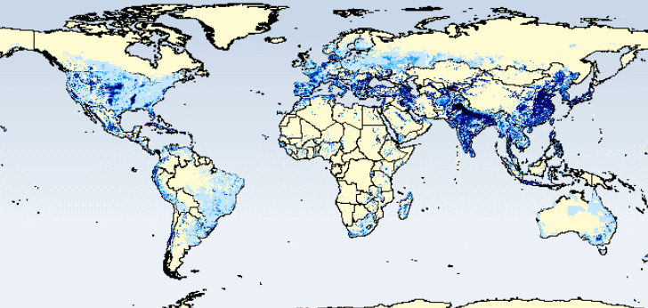
MODIS Annual Global LC (MCD12Q1)
resolution: 15 seconds (~500m)
variables: primary cover (17 classes), confidence (%), secondary cover
time span: 2001-2008
Harvested Area and Yields of 175 crops (Monfreda, Ramankutty, and Foley 2008)
resolution: 5 minutes (~9km)
variables: harvested area, yield, scale of source
time span: 2000 (nominal)
Global Irrigated Areas Map (GIAM) International Water Management Institute (IWMI)
resolution: 5 minutes (~9km)
variables: various crop system/practice classifications
time span: 1999 (nominal)
Notes:
Data sources

Slide 36
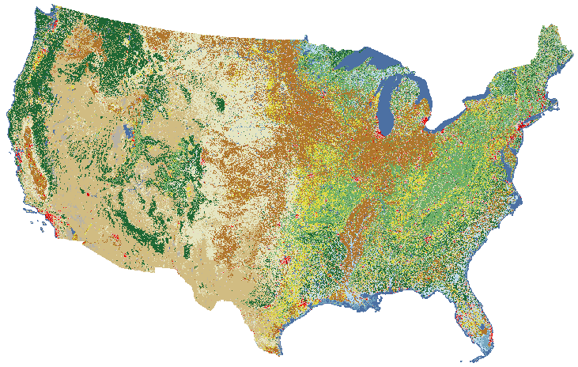
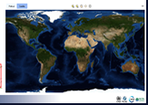
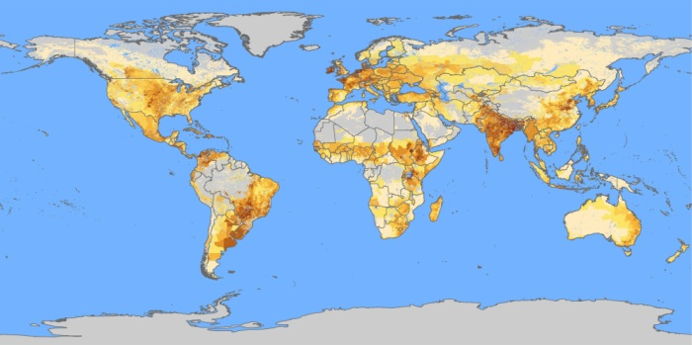
NLCD 2001
resolution: 1 second (~30m)
variables: various classifications including 4 developed classes and separate pasture/crop cover classes
time span: 2001
World Database on Protected Areas
resolution: sampled from polygons; aggr. to 10km
variables: protected areas
time span: 2009
FAO Gridded Livestock of the World (GLW)
resolution: 3 minutes (~5km)
variables: various livestock densities and production systems
time span: 2000 and 2005 (nominal)
Notes:
The National Land Cover Database is a very high-resolution land-cover data set for the US

Slide 37
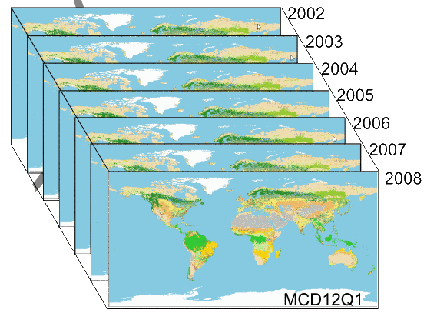
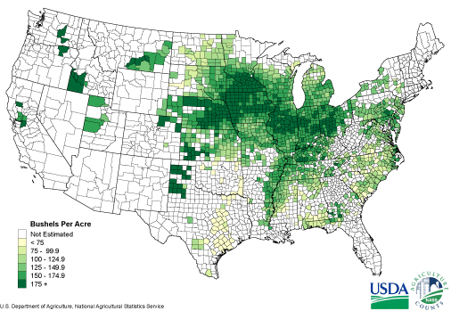
Model evaluation
Building time-series land cover products for validation
Integrating ultra-high resolution regional datasets to improve models
Gather multi-scale inventory data (county, state, nation) over 60 yrs
NLCD 2000
NLCD 2005
Notes:
Validation
The major thrust of our validation agenda is a simulation of land cover and yields over the last 60 years, for comparison with data a variety of scales. These will include a variety of satellite and ground truth products, such as the MCDQ time-series from 2001-2008, the NLCD ultr-high resolution US land cover dataset, which exists for 2001 and 2005, and yield and inventory data at a wide range of scales such as the county level data available in the US going back a century.

Slide 38
Wicked, messy problems
Need for transparency and broad participation
Open source!
Must encompass the entire modeling process
CIM-EARTH
Notes:
Summary:
We are dealing with wicked or messy problems.
Extreme importance, sensitivity to assumptions, political dimensions.
Need for transparency, broad participation, innovation in approaches.
Open source fulfills all of these properties.

Slide 39
Acknowledgements
Numerous people are involved in the RDCEP and CIM-EARTH work, including:
Lars Peter Hansen, Ken Judd, Liz Moyer, Todd Munson (RDCEP Co-Is)
Buz Brock, Joshua Elliott, Don Fullerton, Tom Hertel, Sam Kortum, Rao Kotamarthi, Peggy Loudermilk, Ray Pierrehumbert, Alan Sanstad, Lenny Smith, David Weisbach, and others
Many thanks to our funders:
DOE, NSF, the MacArthur Foundation, Argonne National Laboratory, and U.Chicago

Slide 40
Thank you!
Ian Foster
foster@anl.gov
Computation Institute
University of Chicago & Argonne National Laboratory

